Slide 1


Phishing Awareness: Don't Get Hooked!
Phishing is a cyberattack tricking you into giving sensitive data.
66% of data breaches in 2024 started with phishing emails.
The average data breach cost reached $9.1 million this year.
by Sanu kumar

Slide 2
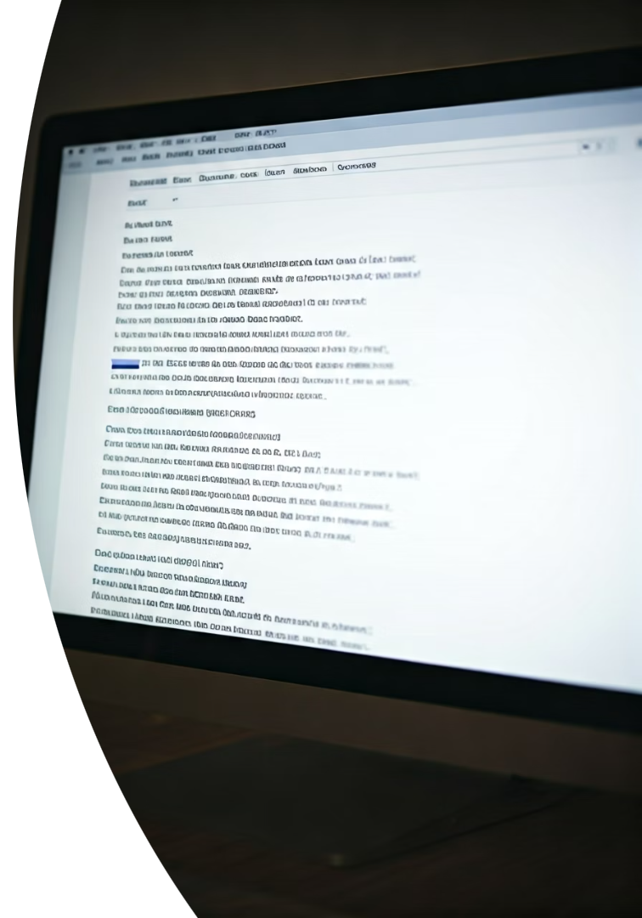




Spotting Phishing Emails: Red Flags
Generic Greetings
Look out for "Dear Customer" instead of your name.
Urgent Language
Emails demanding immediate action often signal phishing.
Suspicious Links
Hover to preview URLs before clicking attachments or links.
Sender Inconsistencies
Mismatch between email address and sender's name is a warning.

Slide 3



Fake Websites: Look Closely!
Check URLs Carefully
Watch for misspellings or different domains like paypaI.com.
Padlock icons signal SSL but aren't foolproof.
Verify Info and Age
Confirm contact details are valid
Use WHOIS to check website age
Beware of excessive personal info requests

Slide 4

Social Engineering: The Human Element
Pretexting
Baiting
Impersonating IT support to gain trust and info.
Offering free gifts to lure victims into traps.
Scareware
Quid Pro Quo
Faking virus warnings to prompt malware installation.
Providing fake services in exchange for data.

Slide 5




Real-World Phishing Examples
BEC Attacks
Spear Phishing
Target corporate employees handling finances — $2.9B lost in 2023.
Highly targeted attacks make up 91% of phishing cases.
Nigerian Prince Scam
Whaling
A classic appeal to greed through fake inheritance claims.
Focused attacks on executives like CEOs and CFOs.
2
3
1
4

Slide 6











Best Practices: Stay Safe Online
Enable MFA
Think Before Clicking
Add extra security layers to your accounts with multi-factor authentication.
Always verify sender identity before opening links or attachments.
Update Software
Install security patches promptly to block vulnerabilities.
Report Suspicious Emails
Alert IT immediately to protect everyone in the organization.
Use Password Manager
Create and store strong, unique passwords securely.

Slide 7

Interactive Quiz: Test Your Knowledge
What are common red flags in phishing emails?
How do you identify a fake website?
What is social engineering?
What action should you take on suspected phishing?

Slide 8





Stay Vigilant: The Fight Against Phishing
Phishing Tactics Evolve
Attackers continually adapt methods to bypass protections.
Continuous Learning
Ongoing education is key to staying safe.
Protect Yourself & Organization
Stay informed and apply best practices consistently.
Helpful Resources
SANS Institute, Anti-Phishing Working Group (APWG)

